Slide 1
November 7, 2024
Thriving Through Transitions
Understanding personal dynamics of organizational change
Jen Erickson, Capacity Building Lead
John Graves, Associate Consultant
Notes:
Jen and John: Welcome and introduce ourselves
Description for Session: In today’s fast-paced world, the amount of change we experience seems to be ever-increasing. However, it’s not the change itself that challenges us the most—it’s the transition we make to account for the change. Understanding this distinction is crucial for navigating life’s uncertainties. Join us for an interactive session designed to equip you with practical tools and a robust framework to manage transitions effectively. This session will delve into strategies for overcoming resistance to change and building a more resilient team, ensuring you thrive even in the most turbulent times.

Slide 2

Who we are
Our core services
We are an internal consulting office that works with academic and administrative units on campus to address organizational challenges, advance strategic priorities, and improve organizational effectiveness.
Strategic planning
Process improvement
Organization design and redesign
Enhancing organizational culture and climate
Project management and delivery
Leadership coaching
Organizational change management
strategicconsulting.wisc.edu
Notes:
Jen and John
We are an internal consulting office that works with academic and administrative units on campus to address organizational challenges, advance strategic priorities, and improve organizational effectiveness.

Slide 3

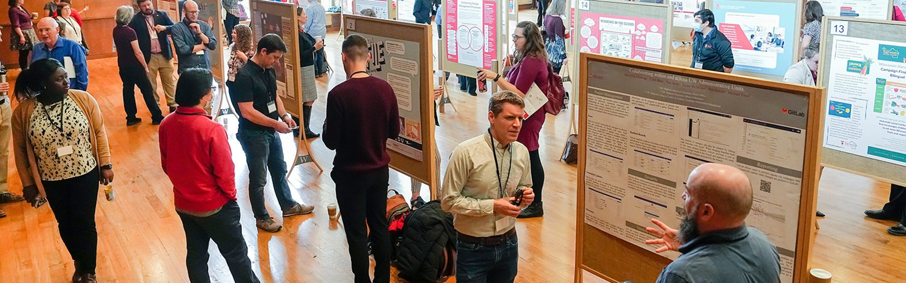
April 17, 2025, at Union South
Free, day-long event
Learn more at https://showcase.wisc.edu/
Notes:
Jen to talk about other CB efforts
The annual Showcase event is designed to celebrate and strengthen a culture of continuous improvement and organizational effectiveness at UW–Madison. It offers an opportunity for colleagues from across campus to share best practices, learn from each other’s successes, and connect.
Showcase is free and open to all UW–Madison faculty, staff, and students, as well as community members. The day includes poster exhibits, poster flash talks, a keynote presentation, and a variety of breakout sessions that highlight campus strategic initiatives and best practices in the areas of process improvement, change management, organizational design, project management, and leadership.
Offer two free online sessions – Ignite: Fueling Org Effectiveness and In Scope: Project mgmt. at UW

Slide 4



Please download and install the Slido app on all computers you use
How do you react to change?
ⓘ Start presenting to display the poll results on this slide.
Notes:
Jen to run
Completely normal to be afraid, resistance, excited, etc.

Slide 5
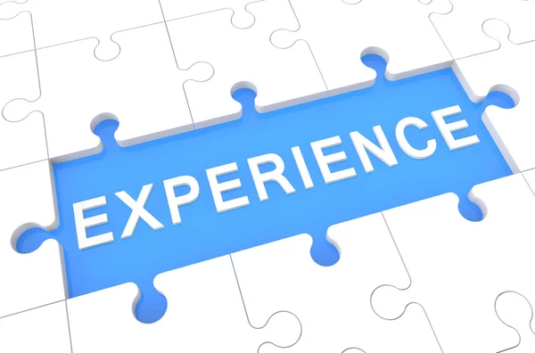
Let us tell you about our experiences with change.
Notes:
John
Story 1
Changing careers

Slide 6
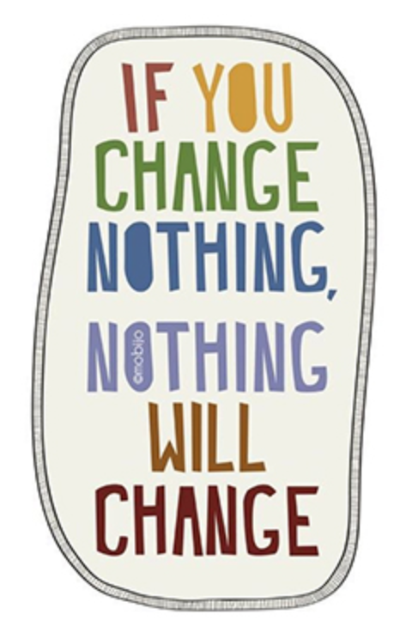
Plan for Today’s Session
Deepen knowledge of how people experience change
Introduce a framework for navigating transitions
Share common responses to change
Discuss strategies for overcoming resistance and building resilience
Notes:
John

Slide 7
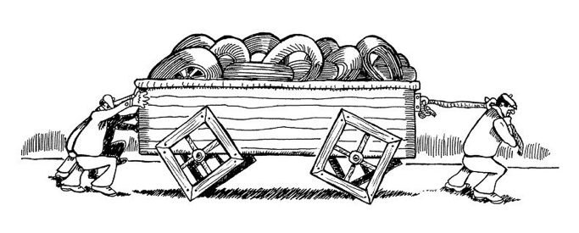
Change is inevitable and essential.
Notes:
Jen
All organizations must change to survive. If you continue to keep doing what you have always done your organization will eventually become outdated, uncompetitive and obsolete.. Have to change to survive. Thus change is inevitable and essential.

Slide 8
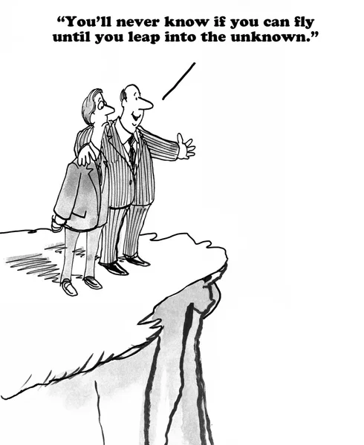
Two types of change: designed and imposed
Designed change is a change that you decide to implement.
Imposed change is a change that is forced upon you.
Source: Kim, Theresa (2023). Understanding and Leading Change.
Notes:
John
There are many types of change, but for this presentation, let's focus on two types: designed change and imposed change.
Designed Change
The change that we implemented
We see value in the change
We see a future state through designed change
Imposed Change
The change was implemented without my input
Challenging to see the value in the change
Resistance and negative emotions are high
Someone’s designed change can be someone's imposed change
Examples of Designed/Imposed Change ask the audience

Slide 9


Change is hard.
We are wired for control and predictability.
When we feel fear and worry, we look for data and facts that support that.
Productive time drops from 6.5 to 1.5 hours/day when concerned about change.
Jeff Chan, UW-Madison School of Business Center for Professional & Executive Development.
Notes:
Jen
Change is hard. This is not easy work.
Humans are wired for control and predictability. When expectations don’t equal perceptions we get adversity. This is a normal human reaction.
Also there is this thing thing (related to our brain function) called the Reticular activation system (RAS): This system filters information based on what you think is important. All cars look black when looking for black. When we feel fear and worry – we look for data and facts that support those concerns. Again this is normal.
Why this is important is because productivity time drops significantly – productivity can drop 6.5 hours per week to 1.5hours when the rumors are flying and we worried or concerned concern about a change.
The reason I bring this up to underscore how important this is that we are intentional, and thoughtful about leading a change process.
Signature for change
Ask all employees on your video conferencing call to sign their names 1 times on paper. This should take a minute; promptly ask them to do it again. Once done, instruct employees to put the pen in their other hand and do 1 signatures again.
Initiate a conversation about how hard signing their name was using their opposite hand and any challenges that arose.
Now, ask them to sign their signature again 3 times. Most people will use their usual hand, but why did they switch back? The instructions didn’t change. The point of the exercise is to demonstrate how difficult change can be, and most people will revert to what they know unless they are making a concerted effort to implement change.

Slide 10
Change is a process.
Tend to start here.
Desired
State
Present
State
Transition State
Where you are today
Time
Where you want to be
Notes:
Jen
What is change? Change is a process. We start in our current state and then develop a vision for the desired future state
We communicate that vision for the desired state. We plan for the desired state. Then we act….and all goes well, right?
Think back to a personal or organizational change you’ve experienced. Did it all go as planned? Was it easy? Did you reach the desired state as was intended?
A lot happens in that transition state and it can mean the difference for reaching the desired state or not.
As a leader when you think about a change initiative it is natural to think first about the outcome you are trying to achieve and then create a plan to get you there step by step. Unfortunately approaching organizational change in this way can lead to failure. To understand why you need to understand the difference between change and transition.
Leaders – start with outcome, then plan to get there, execute the plan. Unfortunately approaching change this way leads to failure. Need to understand change vs transition. Change is focused on outcomes. Transition is internal and how people feel. (assume transition will happen). Change can be quick/transition takes longer.

Slide 11

“It isn’t the changes that do you in, it’s the transitions.”
- W. Bridges
Change | Transition
External | Internal
What we do/outcomes | Who we are, identity
Visible | Invisible
Physical | Emotional, Psychological
Faster | Slower
 | Not optional/Required
Notes:
Jen
Change is external to people – happens to them whether they like it or not.
Transition- Internal psychological that people go through as they internalize and come to terms with details of a new situation that change brings about.
Required for change to be successfully implemented.
Examples of change – new job, move, have baby, get fired, health issue,
Most leaders focus on change not transition.
What is the difference between change and transition?
Change is the external event or situation that takes place. A new business strategy, a turn of leadership, a merger or a new product. The organization focuses on the desired outcome that the change will produce, which is generally in response to external events. Change can happen very quickly.
Transition is the inner psychological process that people go through as they internalize and come to terms with the new situation that the change brings about.
Empathetic leaders recognize that change can put people in crisis. The starting point for dealing with transition is not the outcome but the endings that people have in leaving the old situation behind.
Change will only be successful if leaders and organizations address the transition that people experience during change. Supporting people through transition, rather than pushing forward is essential if the change is to work as planned. This is key to capitalizing on opportunities for innovation and creating organizational resilience.
Change without transition is rearrangement

Slide 12
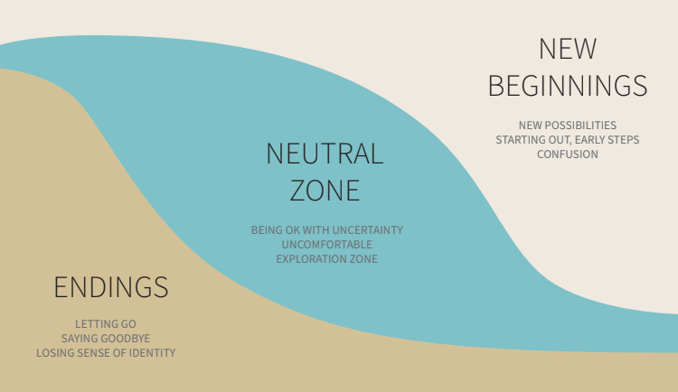
The human response to change is a 3-phase transition process.
W. Bridges. 2016. Managing Transitions: Making the most of Change 4th ed.
Notes:
Jen
The Bridges Transition Model helps organizations and individuals understand and more effectively manage and work through the personal and human side of change.
The model identifies the three stages an individual experiences during change: Ending What Currently Is, The Neutral Zone and The New Beginning.
Starts with ending. Letting go of the old ways and the old identity people had. The first phase of transition is an ending and the time when you need to help people deal with their losses.
Going through an in between time when the old is gone but the new isn’t fully operational. This is the neutral zone when critical psychological realignments and repatterning take place.
Ends with the beginning. Coming out of the transition and making a new beginning. This is when people develop a new identity, experience the new energy, and discover the new sense of purpose that makes the change begin to work.
These 3 stages are not discreet and can happen at the same time.
Two lenses
1. Your Experience: Jen will share Example – transition from faculty to admin services. Ask for Think – Pair – Share
Personal example: Endings: autonomy, reputation after 17 years, community (lived and worked in my community), Ready for a change – knowing the players on campus, tip of spear (lot of personal responsibility, more visible, -New role in a relatively new office – thinking about how I can contribute, add value, help, trying some things…. Building a new network.

Slide 13
“Nothing so undermines change as the failure to think through the losses people face.” – W. Bridges
Listen for what people are giving up.
How does the old model serve some?
How can you address those concerns and help individuals see the value of change?
W. Bridges. 2016. Managing Transitions: Making the most of Change 4th ed.
Notes:
2: Helping others through transitions
---------------------
If you are the one leading change you need to bring people with you if you want change to succeed. Empathetic leaders recognize that change can put people in crisis. The starting point for dealing with transition is not the outcome but the endings that people have in leaving the old situation behind.
Need to be an empathic leader – supporting people through transition.
This is hard for people. Need to let go of old ways.
Those most resistant are those for whom to old model worked. - Example of email.
Change will only be successful if leaders and organizations address the transition that people experience during change. Supporting people through transition, rather than pushing forward is essential if the change is to work as planned. This is key to capitalizing on opportunities for innovation and creating organizational resilience.
The advantage of Bridges’ model is that he understands just how hard change is for many people – in order to move to a new place, one must let go of old ways. Organizations that neglect this fact often see people move back to the old ways as soon as the change is implemented – they want what they lost.
Those most resistant to change are those for whom the old model(s) worked.

Slide 14
Unmanaged transition makes change unmanageable.
G.R.A.S.S.
Guilt | Those who shaped the change and those impacted by the change feel guilty.
Resentment | “yesterday’s changes leave a legacy of resentment; today’s changes are undermined before they are launched.”
Anxiety | Stifles innovation and motivation
Self-Absorption | Causes people to focus on their own concerns and not the concerns of others.
Stress | Affects health and safety.
W. Bridges. 2016. Managing Transitions: Making the most of Change 4th ed.
Notes:
Jen
The starting point for transition is not the outcome but the ending that you will have to make to leave the old situation behind. Situational changes hinge on the new thing, but psychological transition depends on letting go of the old reality and the old identity you had before the change takes place.
Orgs tend to overlook the letting go process completely. And do nothing about the feeling of loss that it generates.
Transition management is a critical skill to develop (self and as a manager). Mismanaged or unmanaged transitions lead to GRASS.

Slide 15
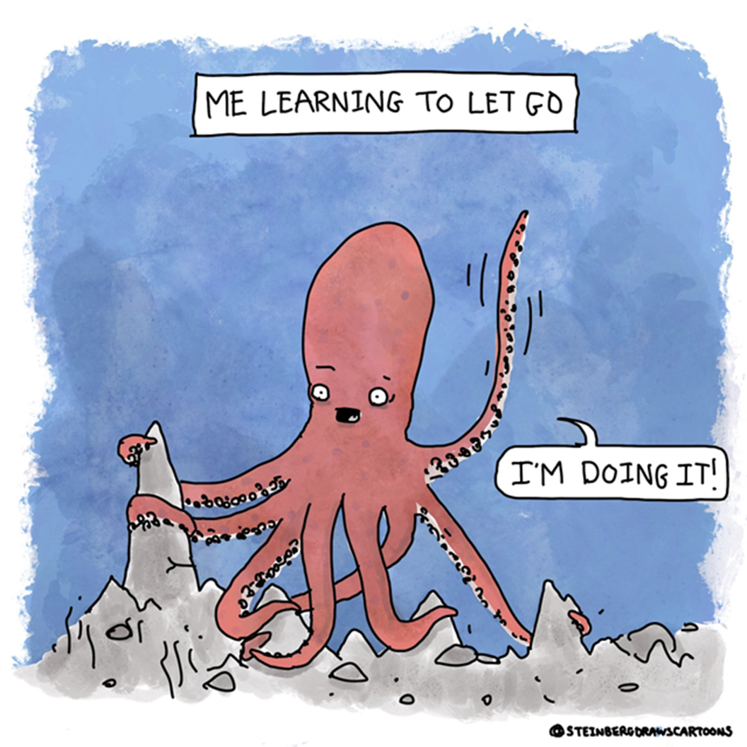
People don’t like endings. How to let go…
Identify and acknowledge what is ending. What are you losing?
Recognize that losses may not be concrete – attitudes, assumptions, expectations, identity, etc.
Expect signs of grieving.
W. Bridges. 2016. Managing Transitions: Making the most of Change 4th ed.
Notes:
Jen
This stuff is hard so I added a bit of comic relief.
Beginnings depend on endings. Before you can become a different person you must let go of your old self. Single reason orgs fail is because no one has thought about the endings or planned to manage the impact on people.
Lots of self-awareness and reflection…. Bring losses into the open.
Grieving – anger, bargaining, anxiety, sadness, disorientation, depression,
From previous activity on transitions – what do you think was lost?
Dukkha: The idea that nothing is permanent and that this transience is painful – Buddhism

Slide 16

Help others to let go…
Can you compensate for the loss?
Mark the endings.
Focus on how the endings ensure continuity.
Treat the past with respect.
Let people take a piece of the past.
Clarify what isn’t changing.
Don’t drag it out.
W. Bridges. 2016. Managing Transitions: Making the most of Change 4th ed.
Notes:
Jen
Beginnings depend on endings. Before you can become a different person you must let go of your old self.
Single reason orgs fail is because no one has thought about the endings or planned to manage the impact on people.
Continuity – More from a manager point of view – what can I give back that will balance what has been taken away? Status, turf, membership, recognition, roles
Clarify what is over and what isn’t – one of the biggest problems with endings
Can’t stay in the endings phase for extended time (needs to be relational to the size of the change)
Dukkha: The idea that nothing is permanent and that this transience is painful – Buddhism

Slide 17
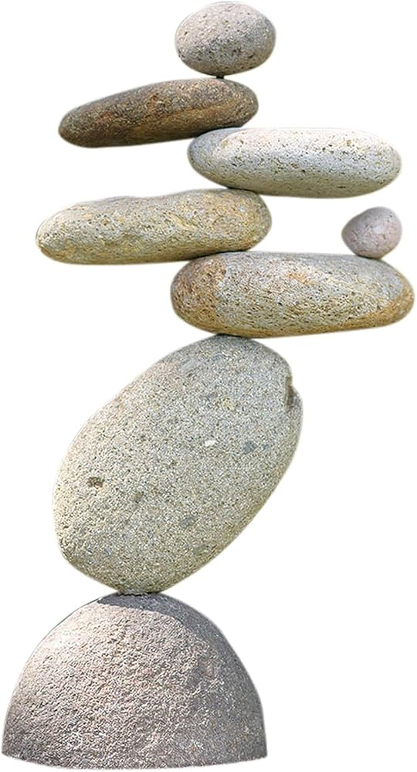
Creating stability is just as important as managing change.
People do best at work when…
their environment is predictable,
they have some sense of control over their immediate surroundings,
they are part of a stable set of relationships,
they feel connected to place and ritual, and
the point of their efforts is readily apparent to them.
https://hbr.org/2024/07/creating-stability-is-just-as-important-as-managing-change
Notes:
Jen
Remember all that stuff I said about change….. The science is clear: people do best at work when their environment is predictable, when they have some sense of control over their immediate surroundings, when they are part of a stable set of relationships, when they feel connected to place and ritual, and when the point of their efforts is readily apparent to them. Seen through the lens of this research, then, constant change emerges as the enemy of performance, not its catalyst.
“Stability management” - look for what is staying the same – leading people focus on that as well.
If teams are working – keep them in tact.

Slide 18
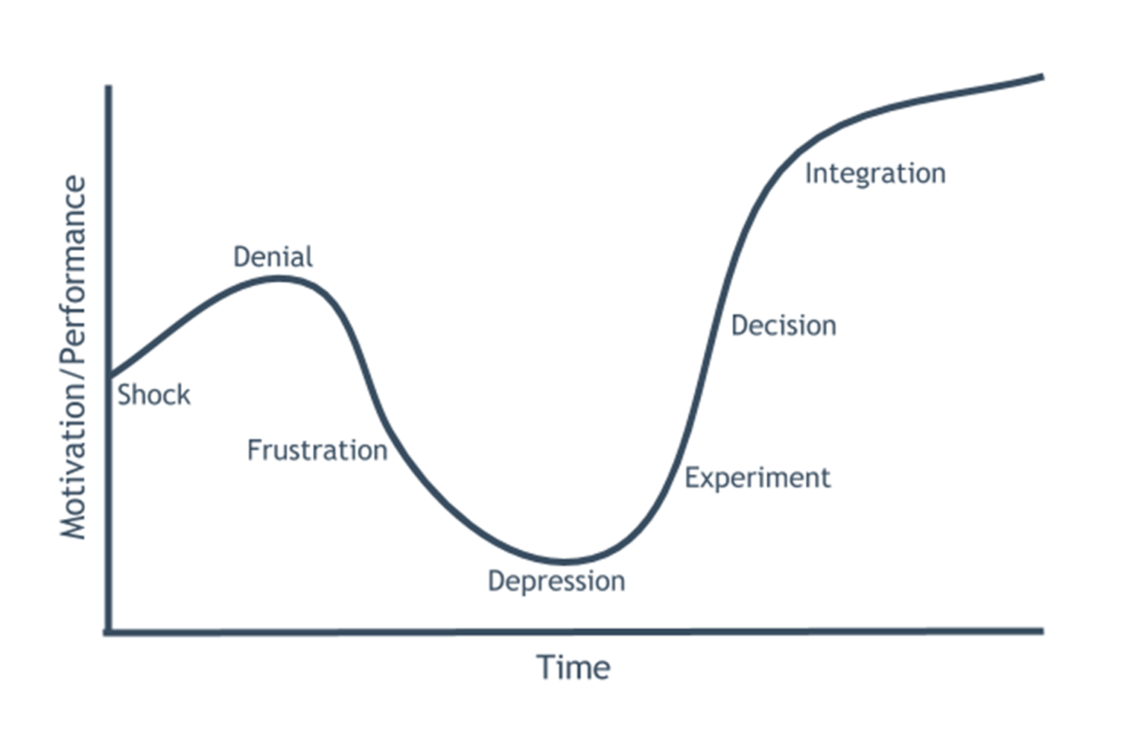
The Kubler-Ross Change Curve
Notes:
John – Do you want to take these slides to the end of the deck?
Here is a the Kubler Ross Change curve is a great tool that can be used in supporting a teammate.
What is it
The curve represents how people respond to change
It comes from a Swiss American Psychiatrist who studied dying people. These are also known as the “Five Stages of Grief.” (Denial, Anger, Bargaining, Depression, Acceptance)
Your response to change is not linear. You can find yourself moving along the change curve and have a set back that puts you back at a previous emotion
Question for the audience
What benefits do you see in using the Kubler-Ross Change Curve when navigating through change? How do you think it can help individuals or teams manage emotions, adapt to transitions, and ultimately embrace change more effectively?
How do I see value in using the curve
I see value in being able to identify where a colleague may be in their change journey. By understanding where they are it allows me to better support them through their transition.

Slide 19
The Kubler-Ross Change Curve
Valley
of Despair
Notes:
John – Do you want to talk about this?
Here is a the Kubler Ross Change curve also known as the five stages of grief. With a difficult change there may be an initial shock, and then denial that this is happening. Then frustration and depression. However, as the change is being implemented there is time for experimentation with the new change. At that point individuals have the option to make the decision to implement the change. Do they have the desire to make/accept the change?
Human response to change follows a predictable emotional pathway
The key to this model is thinking about how you can support your team as they experience these phases. How can you help them make that decision?
People go through this at different times.
Valley of despair

Slide 20
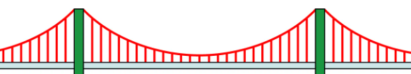
The Kubler-Ross Change Curve
Notes:
Here is a the Kubler Ross Change curve also known as the five stages of grief. With a difficult change there may be an initial shock, and then denial that this is happening. Then frustration and depression. However, as the change is being implemented there is time for experimentation with the new change. At that point individuals have the option to make the decision to implement the change. Do they have the desire to make/accept the change?
Human response to change follows a predictable emotional pathway
The key to this model is thinking about how you can support your team as they experience these phases. How can you help them make that decision?
People go through this at different times.
Valley of despair

Slide 21

Your mindset matters.
Things you care about.
Things you can affect directly.
Covey, S. 2005. Seven Habits of Highly Effective People Guide Book Version 3.0
Notes:
Jen
Mindset matters – We have choice.
Two circles larger outer circle is the “circle of concern” things that you are concerned/care/worried about. There is a smaller inner circle “circle of influence” things you have influence over.
Examples - what is in your circle of concern? Circle of influence?
Power of acceptance – not about passive surrender, but acknowledge the reality of the situation and choosing your response. Surfer rides the waves but does not control the ocean.

Slide 22
Circle of Concern
Circle of Influence
Proactive Focus
Circle of Concern
Reactive Focus
Circle of
Influence
Covey, S. 2005. Seven Habits of Highly Effective People Guide Book Version 3.0
Notes:
Jen – John to add story.
Proactive people focus on what they can influence. Reactive people focus on the circle of concern. See themselves as a victim – look at the person I have to live with, my boss has dead-ended my career.
When people focus on the things they can influence, they expand their knowledge and experience and they build trustworthiness. As a result, their circle of influence grows.
When people focus on the things that they cannot control, they have less time and energy to spend on the things they can influence. Consequently, their circle of influence shrinks.
Example: Husband gets laid off. Very easy to get mad, but spent a day thinking about how we can be proactive. What are specific steps we can take to move in a positive direction?
Covey has done some research on this.. What percentage of people focus on things they can impact rather than on things they can’t? 31%
What is the danger of assuming something is outside your circle of influence? You might fail to make a difference.

Slide 23

In what ways does resistance to change manifest in our work and personal lives, and what are some specific behaviors, attitudes, or situations that indicate this resistance?
Notes:
John
PROSCI –
Top reasons employees resist change
1. Lack of awareness of the reason for the change
2. Changing role
3. Fear
4. Lack of support from and trust in management or leadership
5. Lack of inclusion in the change
Top reasons managers resistance
1. Organizational culture
2. Lack of awareness and knowledge about the change
3. Lack of buy-in
4. Misalignment of project goals and personal incentives
5. Lack of confidence in their ability to manage the people side of change
Audience
What's has been your experiences?
When you reflect on your experiences with change, how do you recognize when you might be actively resisting it?

Slide 24

What strategies or tactics have you found effective for overcoming resistance to change, whether in your personal life or professional environment?
Notes:
John
My experience
I first want to know why we are changing
I identify the negatives in my current state
I identify the positives of the new change
Tactics
Reframe negative thoughts
Educate myself on what is changing
Set realistic expectations

Slide 25

What are your views on the importance of building resilience in the face of change, and what specific approaches do you believe are most effective in fostering that resilience?
Notes:
John
I believe resilience can be developed and strengthened through proper training, which can help individuals cope better with change. However, I recognize that building resilience is not easy, as different types of change—such as personal and professional—can present unique challenges. In my view, resilience can often be more effectively built in a professional context than in personal situations. Here are some strategies I suggest for fostering resilience:
Educate Yourself on the William Bridges Transition Model
Understanding this model can provide valuable insights into the transition process.
Create a Network of Close Friends
Establishing a support network allows you to express yourself and share experiences.
Listen to Understand Before You React
Taking the time to fully understand others' perspectives can help foster empathy and communication.
Ask Clarifying Questions
This practice can help clear up misunderstandings and deepen your understanding of the situation.
Take a Moment to Digest
Allowing yourself time to process information can lead to more thoughtful responses and decisions."
Audience
What are your thoughts?

Slide 26
Thank You!
If you have questions or want more information:
Office of Strategic Consulting
strategicconsulting.wisc.edu
John Graves, Associate Consultant
John.graves@wisc.edu
Jen Erickson, Capacity Building Lead
jennifer.erickson@wisc.edu
Notes:
Jen and John - Q&A

